Slide 1



INVENTORY MANAGEMENT SYSTEM IN PYTHON
Presented by
S.M. TAUKIR RAHMAN
241-56-005

Slide 2

INTRODUCTION
What is an Inventory Management System?
A system to track and manage items in an inventory.
Helps businesses keep track of the stock of products, update quantities, and remove items as necessary.
Objective:
To build a simple Inventory Management System using Python's object-oriented programming (OOP) principles.

Slide 3
Classes & Objects
Using Python classes to structure the system.
Dictionary for Storage
Storing inventory data in a dictionary.
Basic Operations
Add Item
Update Item
Remove Item
View Inventory
CONCEPTS
COVERED

Slide 4
1. Inventory Class
Defines the inventory system and its operations:
add_item()
update_item()
remove_item()
view_inventory()
2. Menu System
A simple interactive menu that allows the user to:
Add items, update, remove, or view the inventory.
THE CODE
STRUCTURE

Slide 5
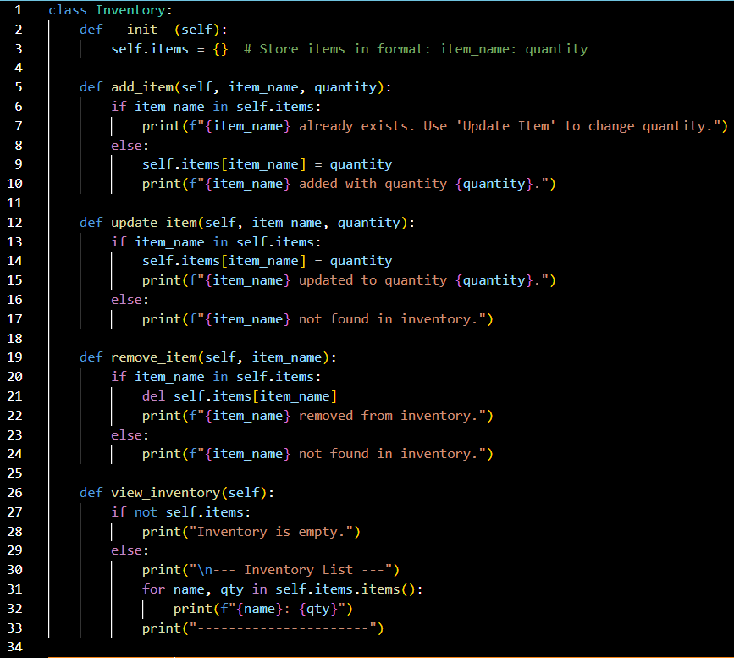
CLASS DEFINITION - INVENTORY

Slide 6

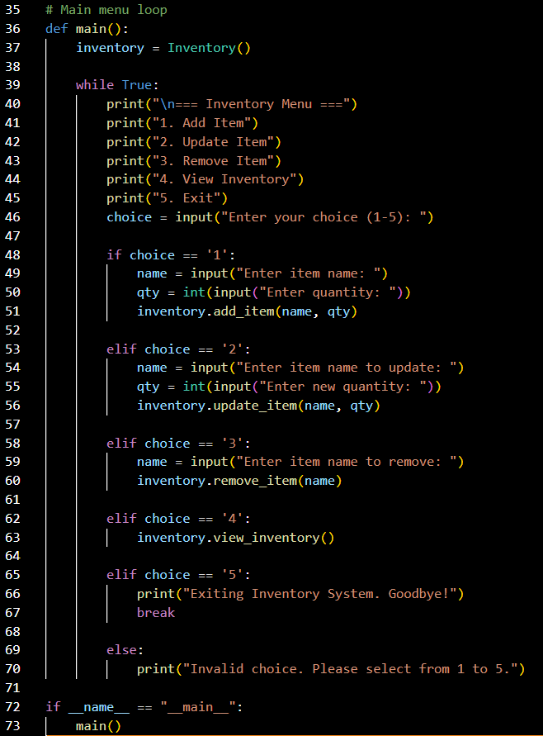
MENU SYSTEM

Slide 7
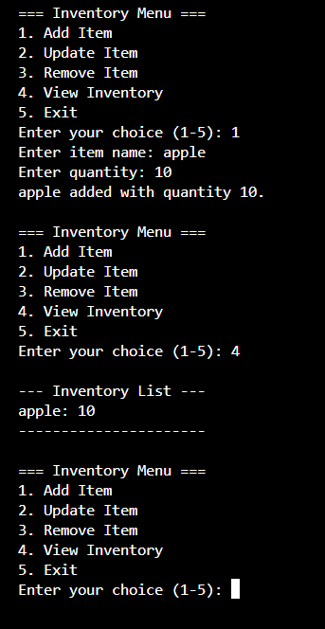
SAMPLE OUTPUT

Slide 8
THANK YOU!

